Slide 1



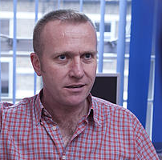

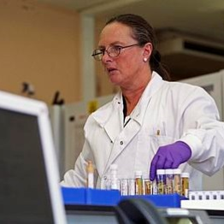

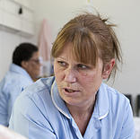

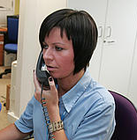



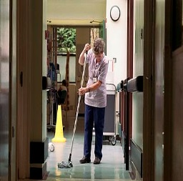



National Guardian
Freedom to Speak Up
Paper 2
The National Guardian Office Session on
Co-Production
What are Freedom to Speak up Guardians?
January 2017

Slide 2
Case Reviews - Introduction
National Guardian
Freedom to Speak Up
Francis Report Principle 15
The National Guardian should review the handling of concerns raised by NHS workers and/or the treatment of the person or people who spoke up
The review should advise NHS organisations to take appropriate action where they have failed to follow good practice
Advise the relevant systems regulator to make a direction to that effect

Slide 3
Case Reviews – The process
National Guardian
Freedom to Speak Up
National Guardian’s Office receives referrals for cases for review
NGO selects cases to review on the basis of suggested criteria
Co-production group to provide advice and guidance on establishing selection criteria
NGO reviews cases on the basis of 20 principles in the Francis report and NHS whistleblowing policy April 2016 and other ideas and suggestions
Case review reports to make recommendations where the need for improvements are identified
Reports are published? and specifically shared with key stakeholders? including person raising original concern
Compliance with necessary improvements reviewed by NGO – referral to NHSI, NHSE and CQC where required

Slide 4
Case Reviews:
Your advice and guidance
National Guardian
Freedom to Speak Up
Please give us your advice and guidance on the following:
The criteria to select cases for review
What the greatest challenges of reviewing cases will be and how to meet those challenges
Deadline for receipt of comments = 20th February 2017

